Slide 1
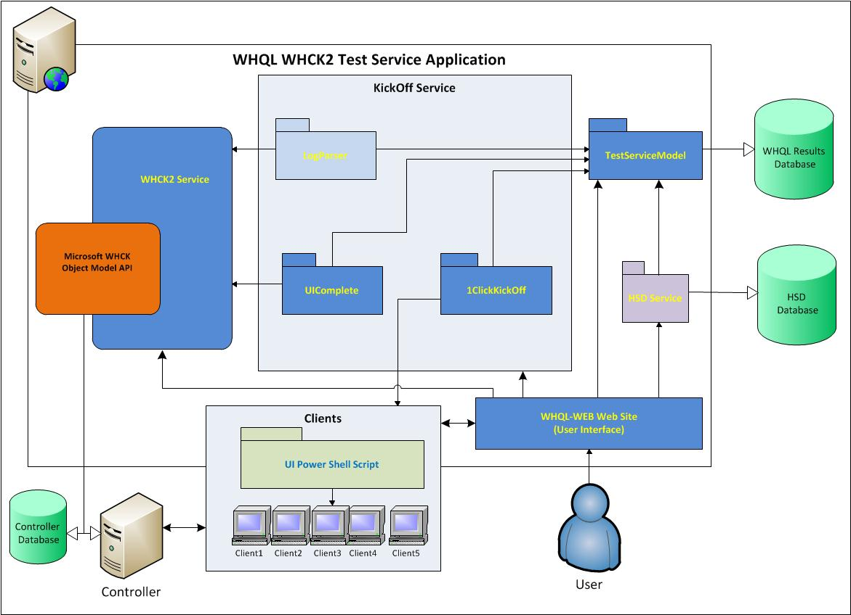
WHQL TestService Automation Design

Slide 2
Simplified Test Cycle Flow with Automation
WHQL WEB
Create Cycle
Kickoff Cycle
(Calls Kickoff Service To Start UI)
KickOff-Svc
Create configuration file on client and run UI script
Reboot clients
UI
UI Clients
Notify UIComplete Service when ready
KickOff-Svc
Add Client to the UIComplete Queue for WHCK configuration
Queue
See next slide
WHQL WEB
View Results
Compare Results
WHQL SQL
Holds test Results
KickOff-Svc
(DTMLogParser)
Transfers test Results to
WHQL SQL
KickOff-Svc
Run Tests

Slide 3
Queue
Install OS, drivers, WHCK client
Add Client to the Queue
Queue
One-time task
Create Machine Pool (first client only)
Unsuccessful
For each machine
Create Device Family (first client only)(add HwID)
Create Project (first client only)
Create Target Family (first client only)
Move Machine to Pool (set to Ready)
Create Target
Schedule Tests (delete “Not Run” tests)
Run Tests, Collect Results, Prepare Submission

